Slide 1
Determining if Marketing Leads Will Convert
Paul Butler

Slide 2
The Problem
Marketing team at X Education needs a strategy for improving lead conversion rate.
Lead Conversion is currently at 38%.
Marketing team wants a system that can rank, and sort leads into hot or cold categories based on the likelihood of conversion.
Once this has been achieved new strategies can be developed with less uncertainty.

Slide 3
Data Set
Data for 9240 prospects who were in contact with the marketing team.
37 Variables including:
Subjective employee ratings of each prospect
Web activity of prospects
Lead source and marketing channel information
Basic location info
Permissions for follow-up contact

Slide 4
Initial problems for Data Set
Missing data
Highly similar data
Data that has only one value

Slide 5
Few Obvious Relationships Apparent in the Data
Subjective ratings were only predictive for extreme values.
The only employment category more likely to convert than not were working professionals.
No apparent major difference between conversion in India, than outside of India.
No major difference between conversions by city.
Only one modest correlation in web activity.

Slide 6
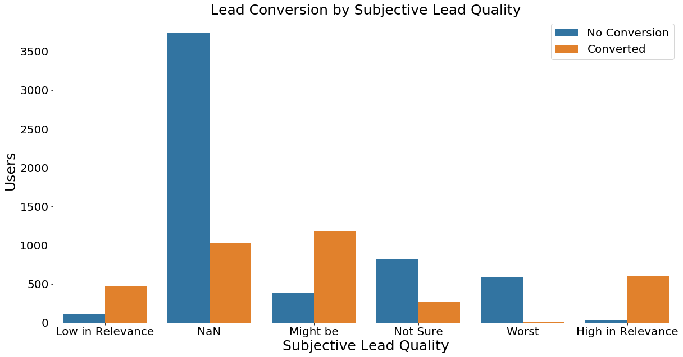
Few Obvious Relationships cont.

Slide 7
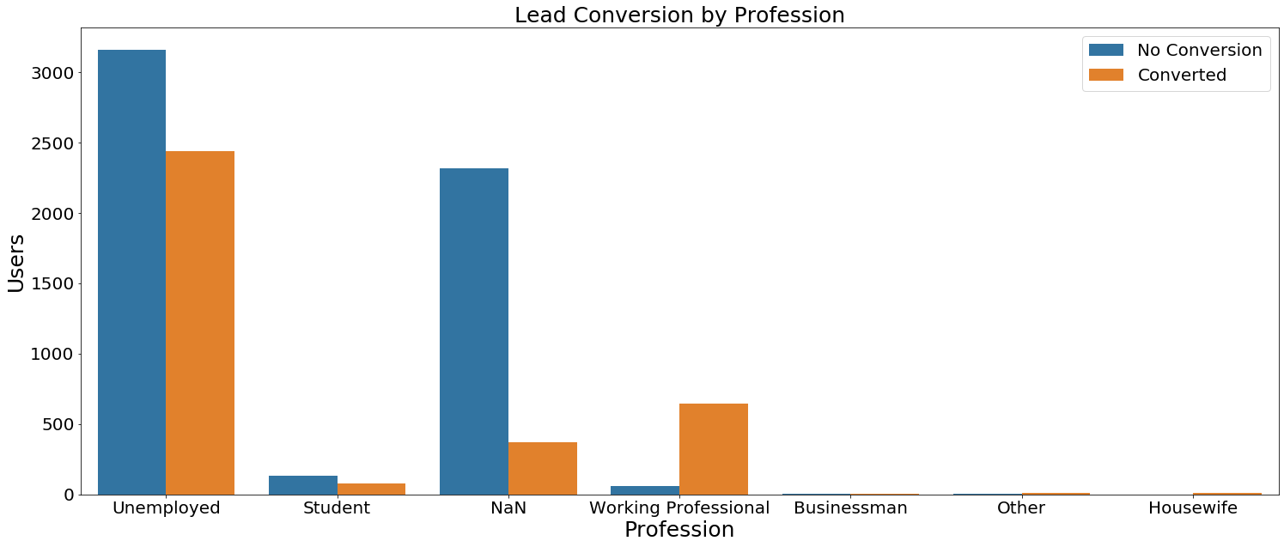
Few Obvious Relationships cont.

Slide 8
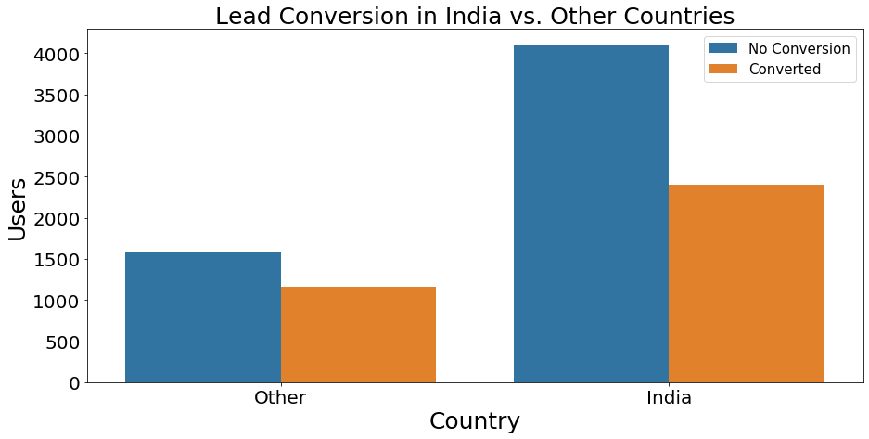
Few Obvious Relationships cont.

Slide 9
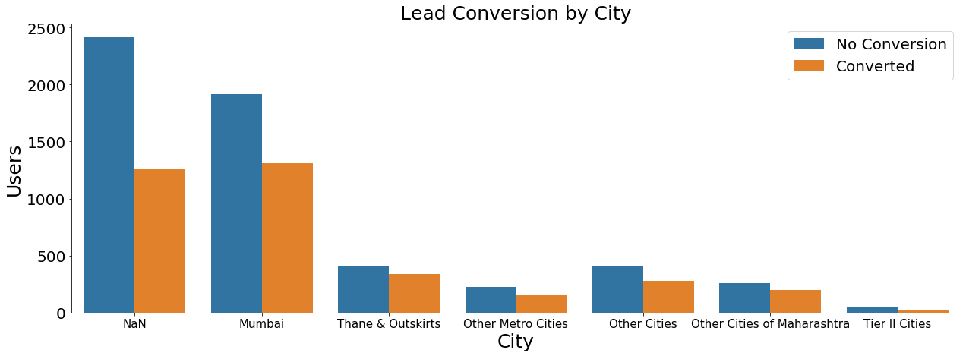
Few Obvious Relationships cont.

Slide 10
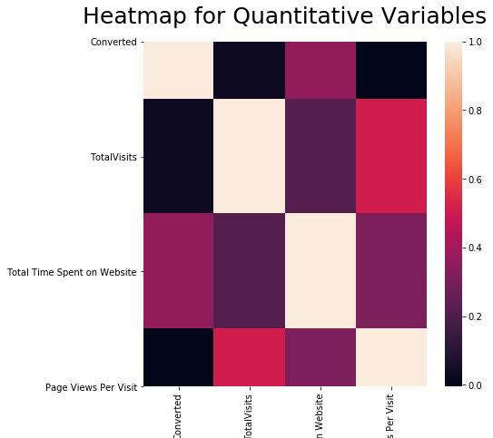
Few Obvious Relationships cont.
Only continuous data was website activity
Total Visits has modest correlation with Page Views Per Visit.
No other obvious correlations

Slide 11
Finding the Nonobvious relationships
Use of Machine Learning – Logistic Regression
Model overview:
Binary Classifier of 0 for no conversion and 1 for conversion.
Also report the predicted chance in order to rank leads.
Technologies used
Stats model for model evaluation.
Scikit-learn for model building.

Slide 12
Model Steps
Split data using stratified 80/20 train/test split.
This allows part of the data to be unseen by the model until testing – this allows us to confirm accuracy of model.
Recursive Feature Elimination –Allows us to select the most useful features.
Manual elimination of nonsignificant features using stats model –remove features that are not contributing well to model.
Check Variable Inflation factor on remaining factors – ensure model is not inaccurately based on a small number of features.

Slide 13
Model Accuracy
Training Accuracy: 91%
Testing Accuracy: 90%
This indicates that the model is very accurate overall and is capable of being 90% accurate for new data not used when training the model.
Other evaluation metrics used:
Cross validation – ensuring repeated trials of the model preform accurately using different sets of data.
Confusion matrix – ensuring model does not have significant differences between predicting different types of outcomes.

Slide 14
Final Remaining Features
 | coef | std err | z | P>|z|
Last Notable Activity_SMS Sent | 2.1505 | 0.219 | 9.819 | 0.000
Asymmetrique Activity Score_15.0 | 1.5885 | 0.255 | 6.240 | 0.000
What is your current occupation_Unemployed | 1.4446 | 0.195 | 7.419 | 0.000
What is your current occupation_Working Professional | 2.8423 | 0.938 | 3.030 | 0.002
Lead Quality_Worst | -2.3113 | 0.721 | -3.204 | 0.001
Tags_Already a student | -3.2659 | 1.060 | -3.082 | 0.002
Tags_Closed by Horizzon | 5.0557 | 1.024 | 4.939 | 0.000
Tags_Interested in other courses | -3.9045 | 1.030 | -3.793 | 0.000
Tags_Lost to EINS | 4.4834 | 0.847 | 5.296 | 0.000
Tags_Ringing | -3.7259 | 0.428 | -8.714 | 0.000
Tags_Will revert after reading the email | 4.1441 | 0.390 | 10.639 | 0.000
Final Model Contained 11 Features
4 Negative Predictors
Presence of these features more predictive of a lead not converting
7 Positive Predictors
Presence of these features more predictive of a lead converting

Slide 15
Sample Outcome Format
The model outcome format includes four pieces of information
Lead number of prospect
Lead Score: a 0-100 rating of the chance for lead conversion
The predicted outcome for the model
0 = predicts no conversion
1 = predicts conversion
The actual outcome
0 = Lead did not convert
1 = Lead converted
Lead Number | Lead Score | Predicted Outcome | Actual Outcome
641725 | 9 | 0 | 0
613102 | 39 | 0 | 0
598020 | 98 | 1 | 1
651611 | 97 | 1 | 1
595073 | 93 | 1 | 1
657686 | 97 | 1 | 1
593831 | 25 | 0 | 0
586770 | 1 | 0 | 0
624430 | 99 | 1 | 1
585273 | 70 | 1 | 0

Slide 16
Conclusions
The conversion/non-conversion of leads can be successfully predicted from a small number of features.
Leads can be ranked by the chance of conversion
Machine learning model can predict

